Slide 1
Lecture 3: Logistic regression

Slide 2
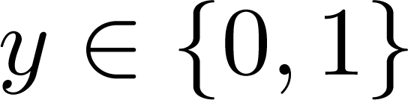
Classification
Email: Spam / Not Spam?
Online Transactions: Fraudulent (Yes / No)?
Tumor: Malignant / Benign ?
0: “Negative Class” (e.g., benign tumor)
1: “Positive Class” (e.g., malignant tumor)

Slide 3
(Yes) 1
Malignant ?
(No) 0
Tumor Size
Tumor Size
Threshold classifier output

Slide 4
x₂
3
2
1
1
2
3
x₁

Slide 5
Perceptron
A perceptron, first introduced in 1958, is a deterministic binary classifier of the following form:
$$h_{θ}(x)=I(w^{T}x+b>0)$$
Recall that $w^{T}x=\left[\begin{matrix}w_{0} & w_{1} & w_{3} & ⋯\end{matrix}\right]\left[\begin{aligned}x_{0} \\ x_{1} \\ x_{3} \\ ⋮\end{aligned}\right]=\underset{i}{∑}w_{i}x_{i}$
$b$: bias term
$I$: Heaviside function

Slide 6
Decision boundary: a linear ‘subspace’ where $w^{T}x+b=0$
$$w^{T}x+b>0$$
$$w^{T}x+b<0$$

Slide 7
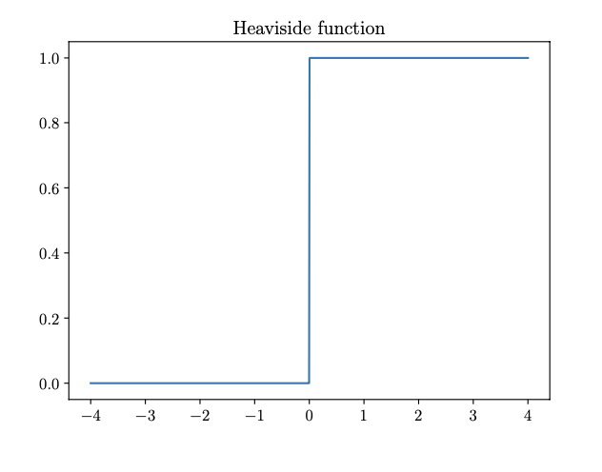
$$w^{T}x+b$$
$$h_{θ}(x)=I(w^{T}x+b>0)$$

Slide 8
Probabilistic formulation
Bernoulli distribution for binary random variables (e.g. outcomes of flipping a coin)
$ψ$: probability of getting the outcome ‘1’ (malignant)
$$\text{Ber}(y|ψ)=\{\begin{matrix}1-ψ & \text{if}y=0 \\ ψ & \text{if}y=1\end{matrix}$$
This can be concisely expressed as
$$\text{Ber}(y|ψ)=ψ^{y}(1-ψ)^{1-y}$$
Model the probability $ψ$ as a function of the input $X$

Slide 9
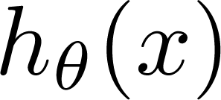
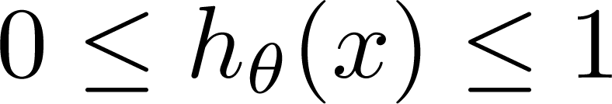
Perceptron: y = 0 or 1
can be 1 or 0
Logistic Regression:

Slide 10
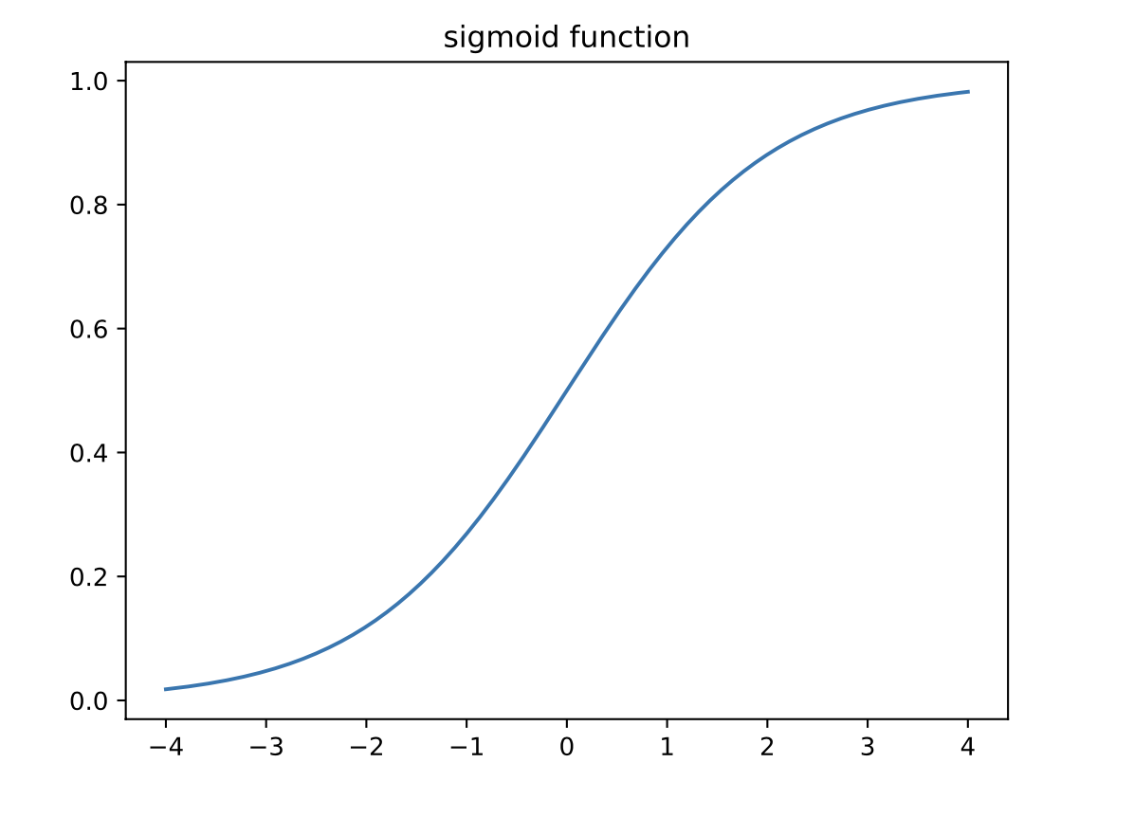
Logistic function
We want $0≤h_{θ}(x)≤1$
We do this using the logistic function
$$h_{θ}(x)=g(w^{T}x+b)=g(θ^{T}x)$$
$$θ^{T}x$$
$$g(z)=\frac{1}{1+e^{-z}}$$
$$θ^{T}x$$

Slide 11


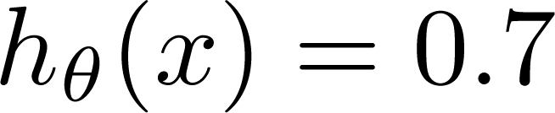
Interpretation of Hypothesis Output
= estimated probability that y = 1 on input x
Example: If
Tell patient that 70% chance of tumor being malignant

Slide 12
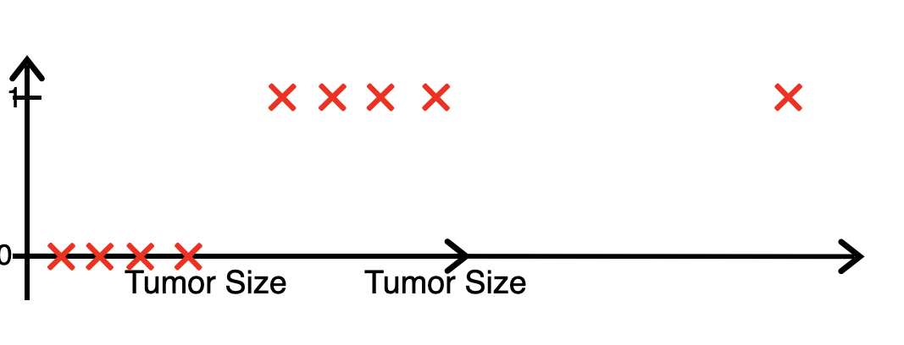
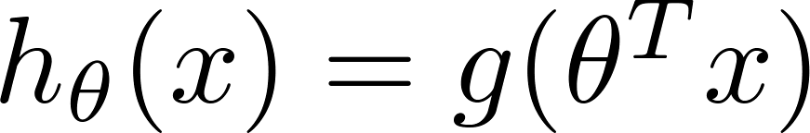
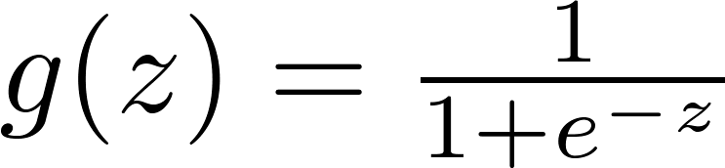

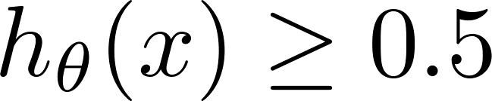

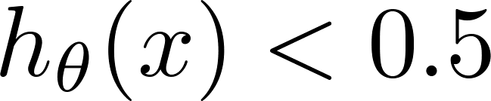
Decision boundary
$$h_{θ}(x)$$
predict “ “ if
predict “ “ if

Slide 13
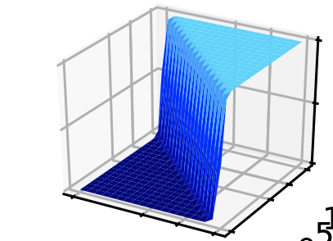
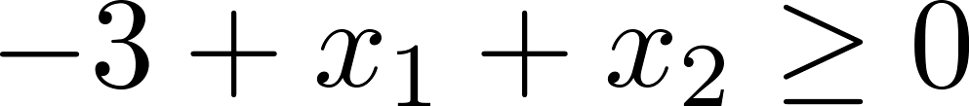
Decision Boundary
$$θ^{T}x>0.5$$
$$θ^{T}x<0.5$$
predict “ ” if
$$h_{θ}(x)$$
predict “ ” if
$$x_{1}$$
$$x_{2}$$

Slide 14
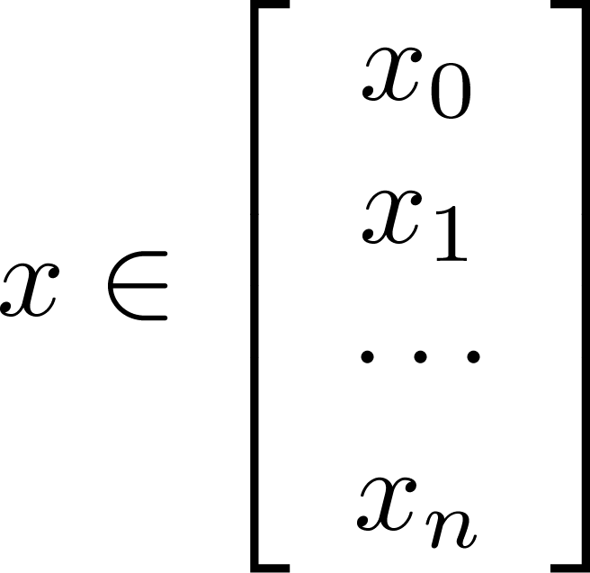
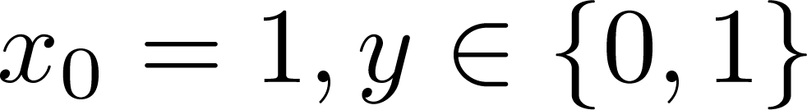
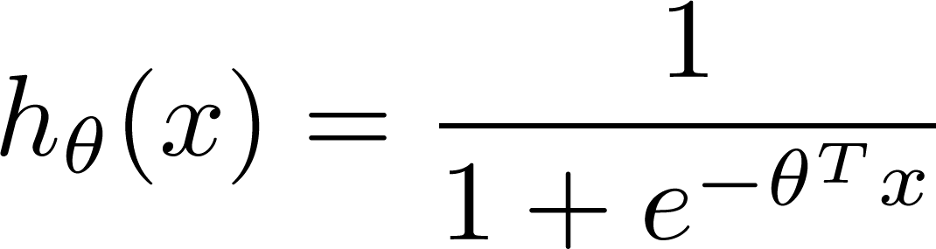
Training set:
$m$ examples
How to choose the parameters $θ$?

Slide 15
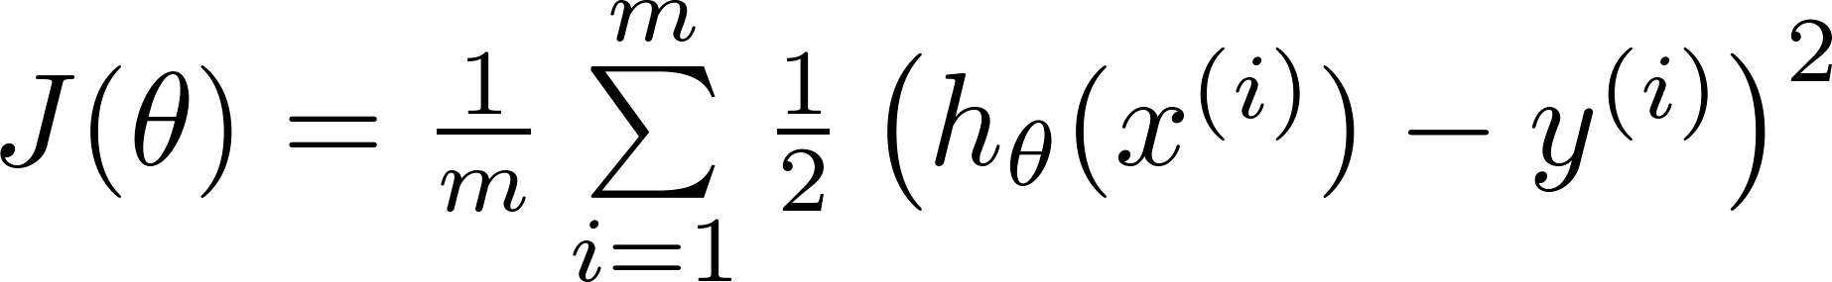
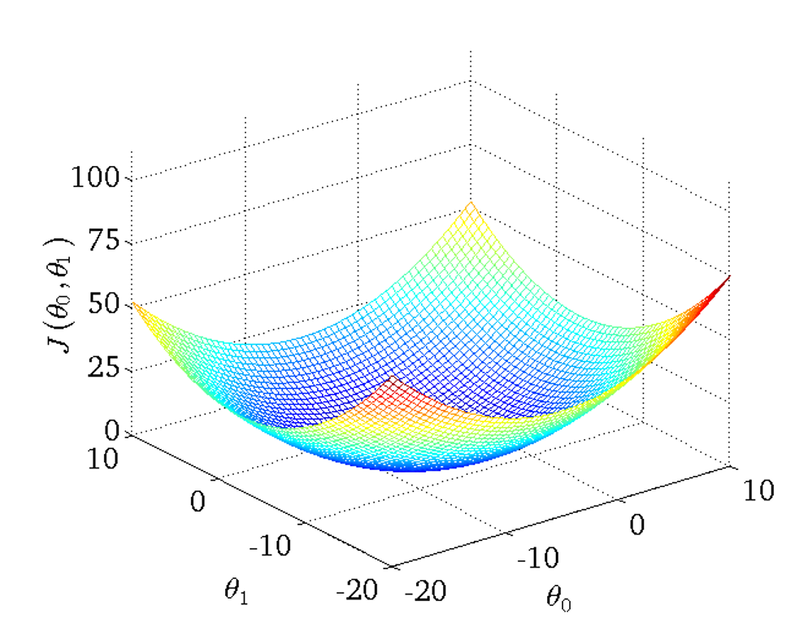
Cost function
Linear regression:

Slide 16
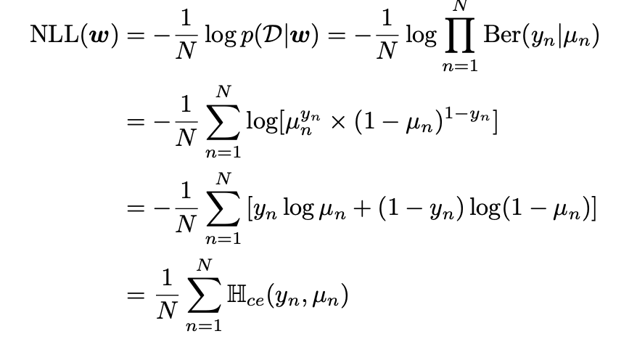
Logistic regression cost function - Likelihood
Likelihood: probability of observing the data given the model parameters
$$\text{Ber}(y|ψ)=\{\begin{matrix}1-ψ & \text{if}y=0 \\ ψ & \text{if}y=1\end{matrix}$$
Likelihood for observing data point $i$:
$$\text{Ber}(y|ψ)=ψ^{y}(1-ψ)^{1-y}$$
$$\text{Ber}\left(y_{i}|h_{θ}(x_{i})\right)=h_{θ}(x_{i})^{y_{i}}×(1-h_{θ}(x_{i}))^{1-y_{i}}$$

Slide 17
Logistic regression cost function - Likelihood
Likelihood for observing data point $i$:
$$\text{Ber}\left(y_{i}|h_{θ}(x_{i})\right)=h_{θ}(x_{i})^{y_{i}}×(1-h_{θ}(x_{i}))^{1-y_{i}}$$
Likelihood for observing all $m$ data points
$$\overset{m}{\underset{i}{∏}}h_{θ}(x_{i})^{y_{i}}×(1-h_{θ}(x_{i}))^{1-y_{i}}$$

Slide 18
Logistic regression cost function - Likelihood
Likelihood for observing all $m$ data points
$$\overset{m}{\underset{i}{∏}}h_{θ}(x_{i})^{y_{i}}×(1-h_{θ}(x_{i}))^{1-y_{i}}$$
We usually work with the negative log likelihood
$$\text{NLL}(θ)=-\frac{1}{m}\overset{m}{\underset{i}{∑}}\left[y_{i}logh_{θ}(x_{i})+(1-y_{i})log(1-h_{θ}(x_{i}))\right]$$

Slide 19
Maximum likelihood
We find the best model parameters $\overset{̂}{θ}$ by maximizing the NLL
$$\text{NLL}(θ)=-\frac{1}{m}\overset{m}{\underset{i}{∑}}\left[y_{i}logh_{θ}(x_{i})+(1-y_{i})log(1-h_{θ}(x_{i}))\right]$$
$$\overset{̂}{θ}={\text{argmin}}_{θ}-\frac{1}{m}\overset{m}{\underset{i}{∑}}\left[y_{i}logh_{θ}(x_{i})+(1-y_{i})log(1-h_{θ}(x_{i}))\right]$$

Slide 20
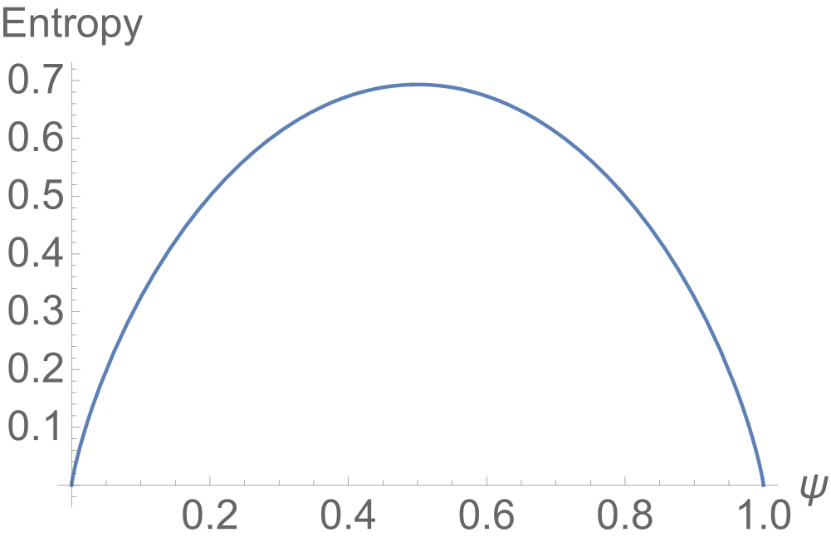
Negative log likelihood is equal to binary cross entropy
The entropy of a distribution
$$H(p)=-\underset{x}{∑}p(x)log(p(x))$$

Slide 21
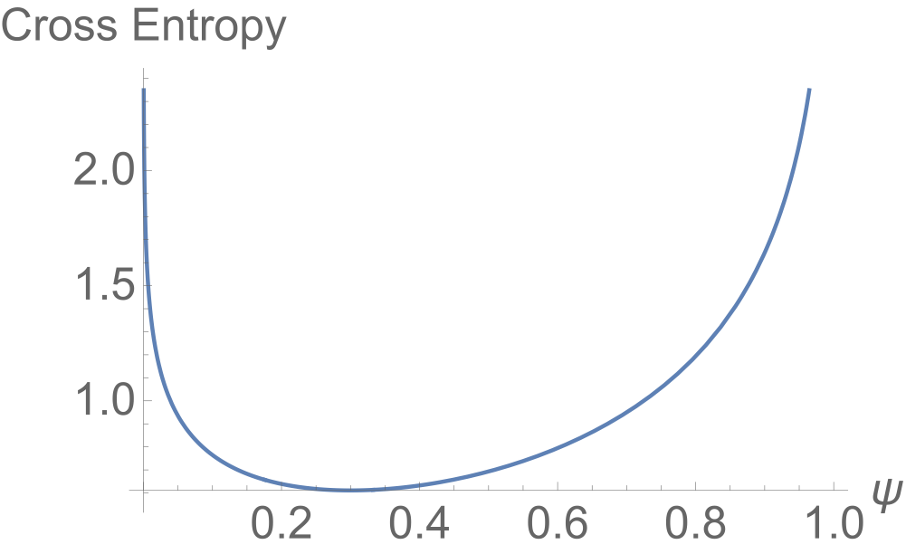
Negative log likelihood is equal to binary cross entropy
The cross entropy between two probability distributions
$$H(p,q)=-\underset{x}{∑}p(x)log(q(x))$$
Cross entropy for two Bernoulli distributions
$$H(p,q)=-\left[plogq+(1-p)log(1-q)\right]$$
cross entropy of $\text{Ber}(ψ)$ relative to $\text{Ber}(0.3)$

Slide 22
Negative log likelihood is equal to binary cross entropy
Equal to the entropy of $p$ and the KL divergence between $p$ and $q$
$$H(p,q)=H(p)+D_{KL}(p∥q)$$
$$\begin{matrix}H(p,q) & =-\underset{x}{∑}p(x)log(q(x)) \\ & =-\underset{x}{∑}p(x)\left(log(q(x))+log(p(x)-log(p(x))\right) \\ & =-\underset{x}{∑}p(x)log(p(x)-\underset{x}{∑}p(x)\left(log(q(x))-log(p(x))\right) \\ & =H(p)+\underset{x}{∑}p(x)\frac{log(p(x)}{log(q(x))}\end{matrix}$$
$$D_{KL}(p∥q)=\underset{x}{∑}p(x)log\left(\frac{p(x)}{q(x)}\right)$$

Slide 23
Negative log likelihood is equal to binary cross entropy
Cross entropy for two Bernoulli distributions
$$H(p,q)=-\left[plogq+(1-p)log(1-q)\right]$$
Consider the data point $i$ as the distribution $p$
Distribution $q$ is the modeled distribution with probability $h_{θ}(x_{i})$
$$H(p,q)=-\left[y_{i}logh_{θ}(x_{i})+(1-y_{i})log(1-h_{θ}(x_{i}))\right]$$
$$\text{NLL}(θ)=-\frac{1}{m}\overset{m}{\underset{i}{∑}}H(y_{i},h_{θ}(x_{i}))$$

Slide 24
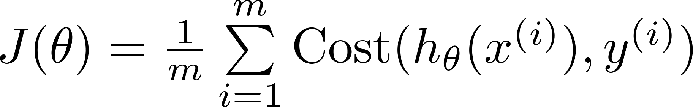

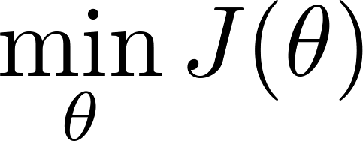

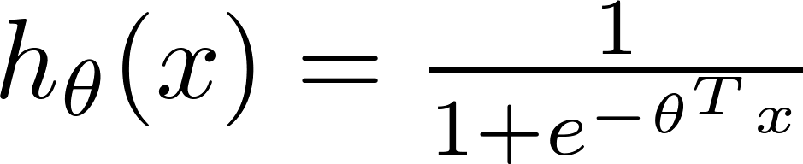
No close form solution exists for the logistic regression cost
To fit parameters :
To make a prediction given new :
Output

Slide 25


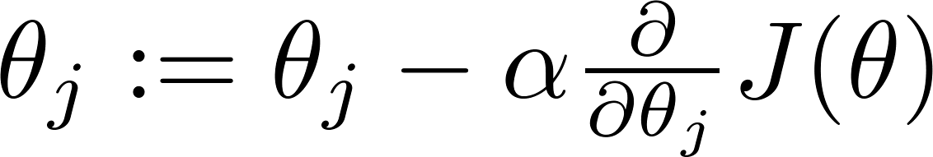


Gradient Descent
Want :
Repeat
(simultaneously update all )

Slide 26
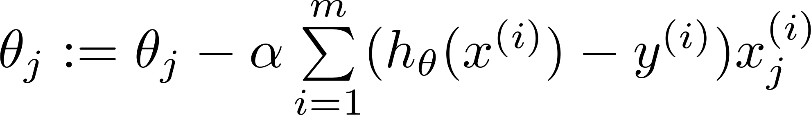
Gradient Descent
Want :
Repeat
(simultaneously update all )
Algorithm looks identical to linear regression!

Slide 27
Multiclass case

Slide 28
Multiclass classification
Email foldering/tagging: Work, Friends, Family, Hobby
Medical diagrams: Not ill, Cold, Flu
Weather: Sunny, Cloudy, Rain, Snow

Slide 29
Binary classification:
Multi-class classification:
x₂
x₂
x₁
x₁

Slide 30

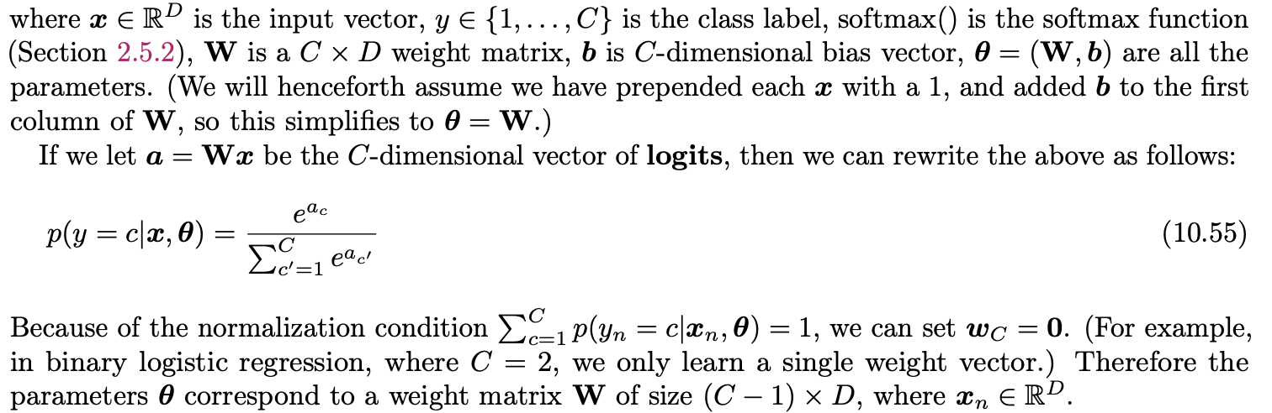
Multinomial logistic regression

Slide 31
Recall in logistic regression
This can be considered as a procedure where we assign two numbers to the two outcomes
$$y=0←0$$
$$y=1←θ^{T}x$$
And renormalized such that their sum is one
$p(y=0)=\frac{e^{0}}{e^{0}+e^{θ^{T}x}}$ and $p(y=1)=\frac{e^{θ^{T}x}}{e^{0}+e^{θ^{T}x}}=\frac{1}{e^{-θ^{T}x}+1}$

Slide 32
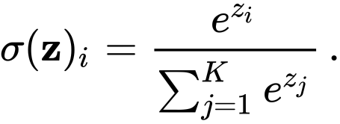
The softmax function generalizes the logistic function

Slide 33
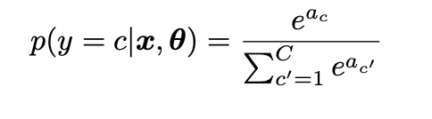
We can build a model for multi-label classification using the softmax function
$$a=\left[\begin{aligned}a_{0} \\ a_{1} \\ ⋮ \\ a_{C-1}\end{aligned}\right]=\left[\begin{aligned}0 \\ w_{1}^{T}x \\ ⋮ \\ w_{C-1}^{T}x\end{aligned}\right]=Wx$$
$W$ is the $C×D$ dimensional weight matrix
$x$ is the $D$ dimensional input vector
And model the output probability using

Slide 34
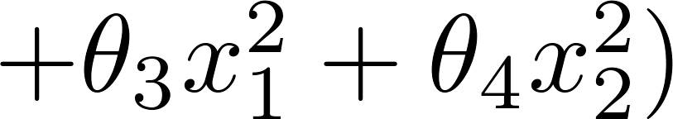
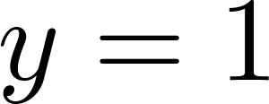
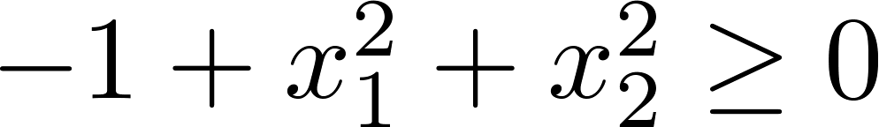
Non-linear decision boundaries
x₂
1
x₁
-1
1
-1
Predict “ “ if
x₂
x₁

